Slide 1



Spring Security - Logout
m

Slide 2


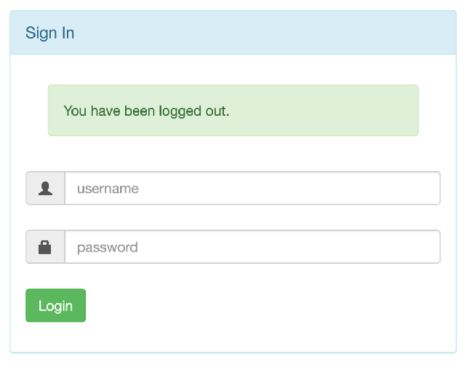
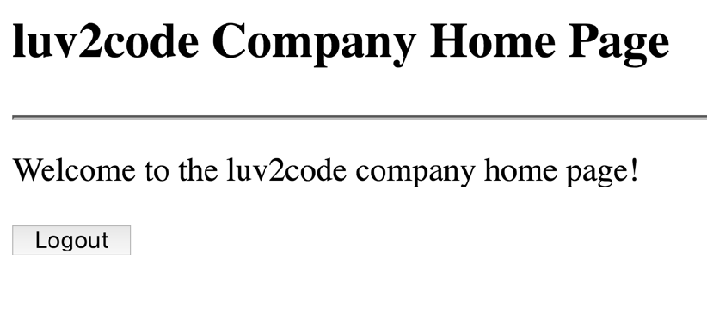

Logging Out
Clear user’s session
www.luv2code.com

Slide 3
Development Process
Step-By-Step
Add logout support to Spring Security Configuration
Add logout button to JSP page
Update login form to display “logged out” message
www.luv2code.com

Slide 4


Step 1: Add Logout support to Spring Security Configuration
@Override
protected void configure(HttpSecurity http) throws Exception {
http.authorizeRequests()
.anyRequest().authenticated()
.and()
.formLogin()
.loginPage("/showMyLoginPage")
.loginProcessingUrl("/authenticateTheUser")
.permitAll()
.and()
.logout().permitAll();
}
Add logout support for default URL
/logout
www.luv2code.com

Slide 5

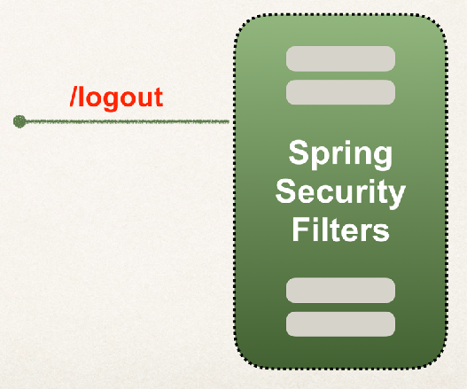

Step 2: Add logout button
Send data to default logout URL: /logout
•
Logout URL will be handled by Spring Security Filters
•
You get it for free … no coding required
This is
Spring Security magic … LOL
www.luv2code.com

Slide 6


Step 2: Add logout button
Send data to default logout URL: /logout
By default, must use POST method
<form:form action="${pageContext.request.contextPath}/logout" method="POST">
<input type="submit" value="Logout" />
</form:form>
GET method is disabled by default
www.luv2code.com

Slide 7
Logout process
When a logout is processed, by default Spring Security will …
•
Invalidate user’s HTTP session and remove session cookies, etc
•
Send user back to your login page
•
Append a logout parameter: ?logout
www.luv2code.com

Slide 8





Step 3: Update login form to display “logged out” message
Update login form
Check the logout parameter
If logout parameter exists, show “logged out” message
JSTL can help with this :-)
www.luv2code.com

Slide 9



Modify Login form - check for "logout"
Use JSTL
File: WEB-INF/view/plain-login.jsp
<%@ taglib prefix="c" uri="http://java.sun.com/jsp/jstl/core" %>
…
<form:form action="…" method="…">
<c:if test=“${param.logout != null}”>
If logout param
then show message
<i>You have been logged out.</i>
</c:if>
User name: <input type="text" name="username" /> Password: <input type="password" name="password" />
</form:form>
…
www.luv2code.com

Slide 10


Modify Login form - check for "logout"
Use JSTL
File: WEB-INF/view/plain-login.jsp
<%@ taglib prefix="c" uri="http://java.sun.com/jsp/jstl/core" %>
…
<form:form action="…" method="…">
<c:if test=“${param.logout != null}”>
If logout param
then show message
<i>You have been logged out.</i>
</c:if>
User name: <input type="text" name="username" /> Password: <input type="password" name="password" />
http://localhost:8080/myapp/showMyLoginPage?logout
</form:form>
…
www.luv2code.com

Slide 11
Cross Site Request Forgery (CSRF)
m

Slide 12
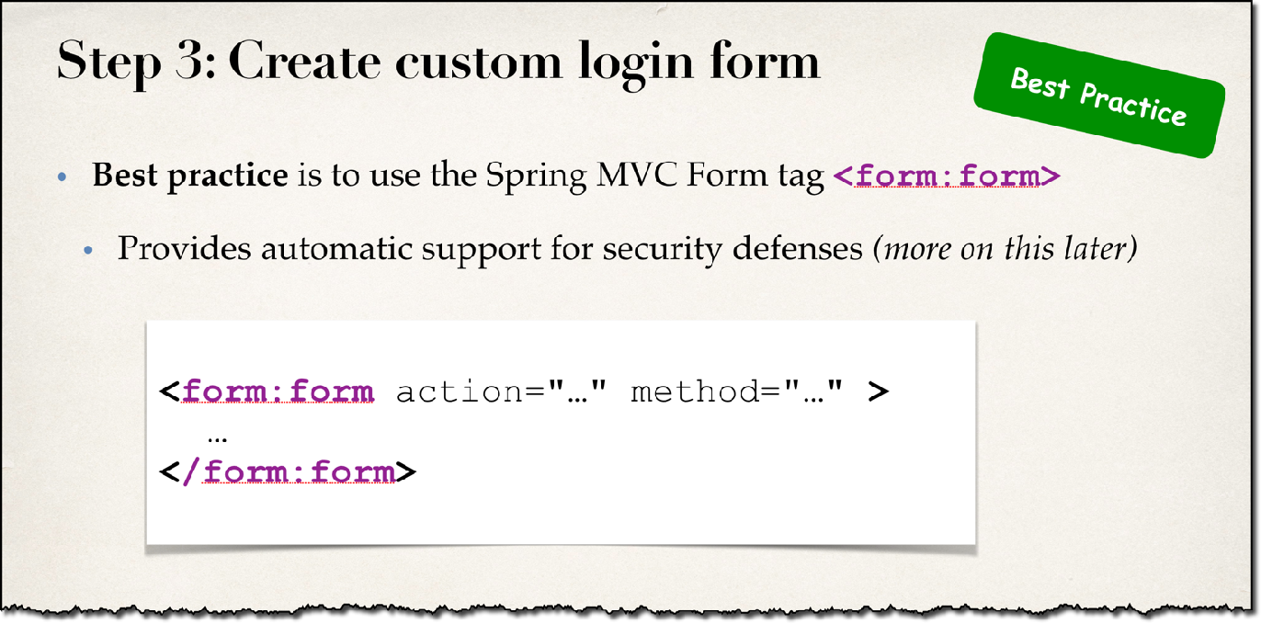
Earlier in the course …
www.luv2code.com

Slide 13
Spring Security
•
Spring Security protects against Cross-Site Request Forgery (CSRF)
www.luv2code.com

Slide 14


What is CSRF?
A security attack where an evil website tricks you into executing an action
on a web application
that you are currently logged in.
www.luv2code.com

Slide 15
CSRF Examples
You are logged into your banking app
tricked into sending money to another person
•
You are logged into an e-commerce app
•
tricked into purchasing unwanted items
www.luv2code.com

Slide 16
CSRF Protection
To protect against CSRF attacks
•
Embed additional authentication data/token into all HTML forms
•
On subsequent requests, web app will verify token before processing
www.luv2code.com

Slide 17


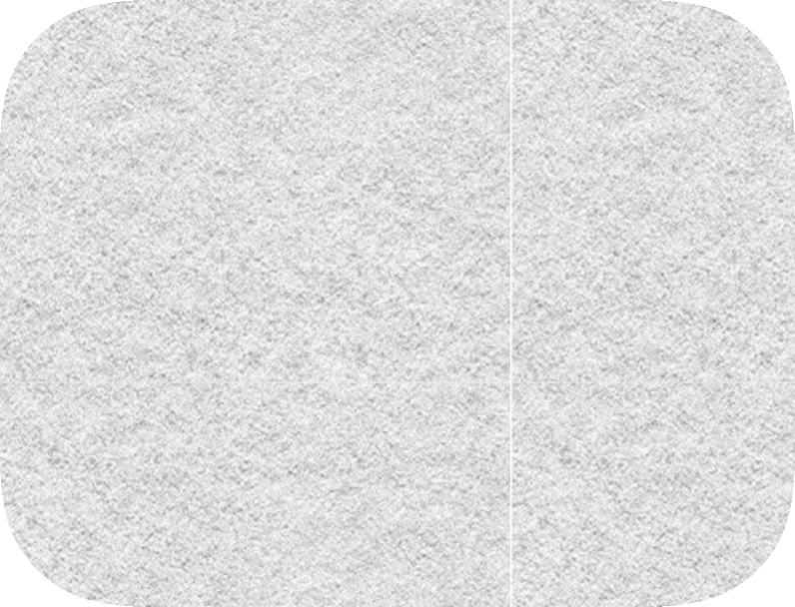




Spring Security Overview
/mytopsecretstuff
CSRF
Protected Web Resource
Spring Security Filters
Web Browser
my app security configuration
users passwords roles
www.luv2code.com

Slide 18

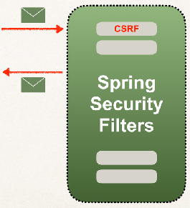
Spring Security’s CSRF Protection
•
CSRF protection is enabled by default in Spring Security
•
Spring Security uses the Synchronizer Token Pattern
Each request includes a session cookie and randomly generated token
•
For request processing, Spring Security verifies token before processing
•
All of this is handled by Spring Security Filters
www.luv2code.com

Slide 19
When to use CSRF Protection?
The Spring Security team recommends
•
Use CSRF protection for any normal browser web requests
•
If you are building a service for non-browser clients
•
you may want to disable CSRF protection (after careful review)
www.luv2code.com

Slide 20
Use Spring Security CSRF Protection
For form submissions use POST instead of GET
•
Include CSRF token in form submission
•
<form:form> automagically adds CSRF token
Best Practice
•
If you don’t use <form:form>, you must manually add CSRF token
www.luv2code.com

Slide 21

Manually add CSRF token
<form action="..." method="POST">
<input type="hidden"
name="${_csrf.parameterName}" value="${_csrf.token}" />
</form>
www.luv2code.com

Slide 22
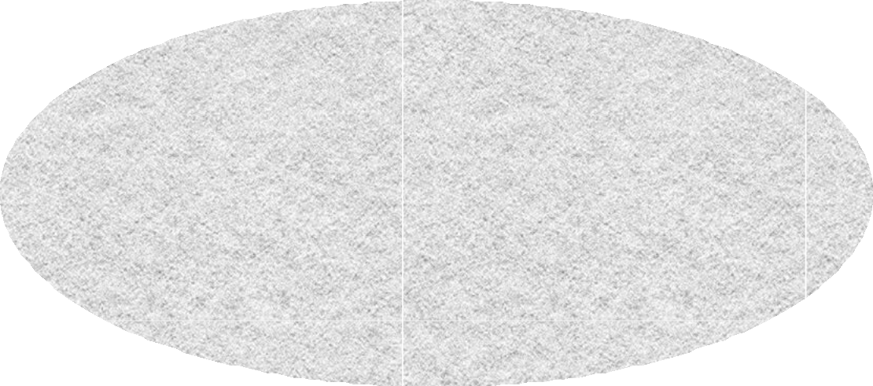

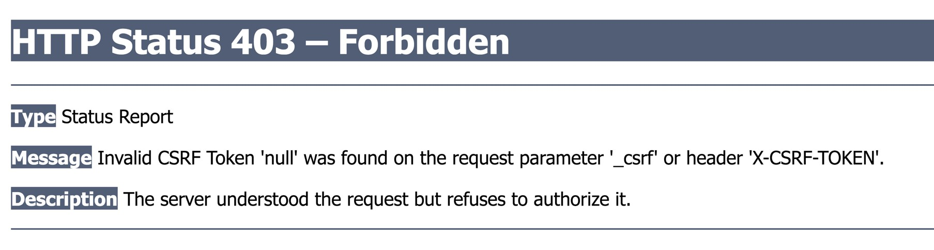
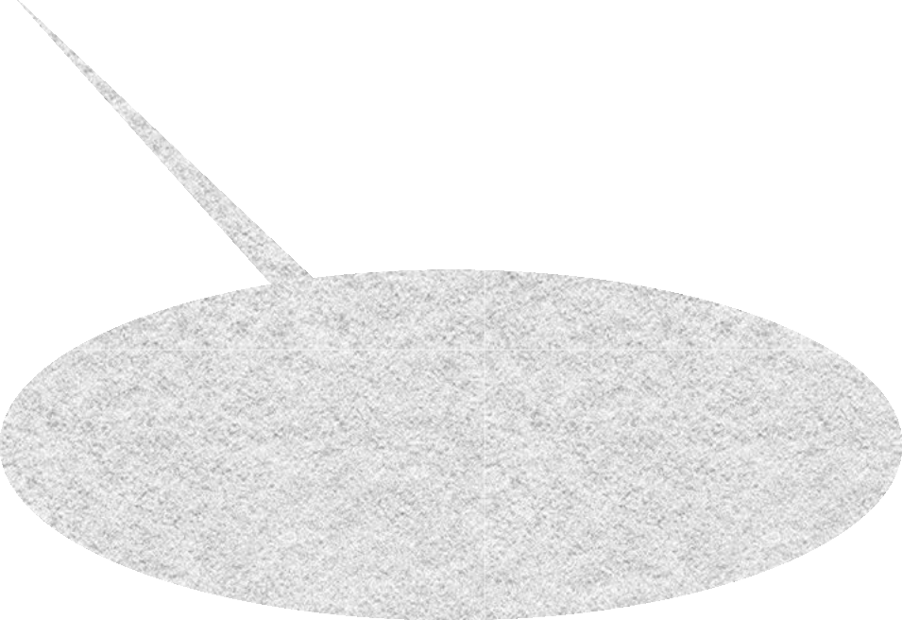
What happens if you don’t include CSRF token?
Let’s Break It!
Token was not included
www.luv2code.com

Slide 23
CSRF Resources
•
CSRF Security Reference
•
https://www.owasp.org/index.php/Cross-Site_Request_Forgery_(CSRF)
•
Spring Security CSRF Support
•
https://docs.spring.io/spring-security/site/docs/current/reference/htmlsingle/#csrf
www.luv2code.com

